Slide 1


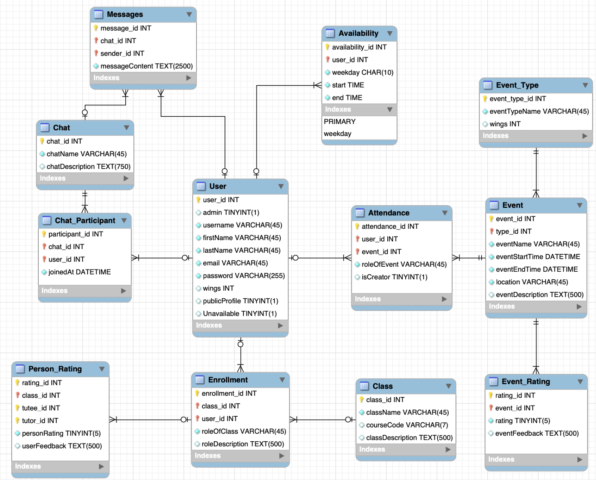
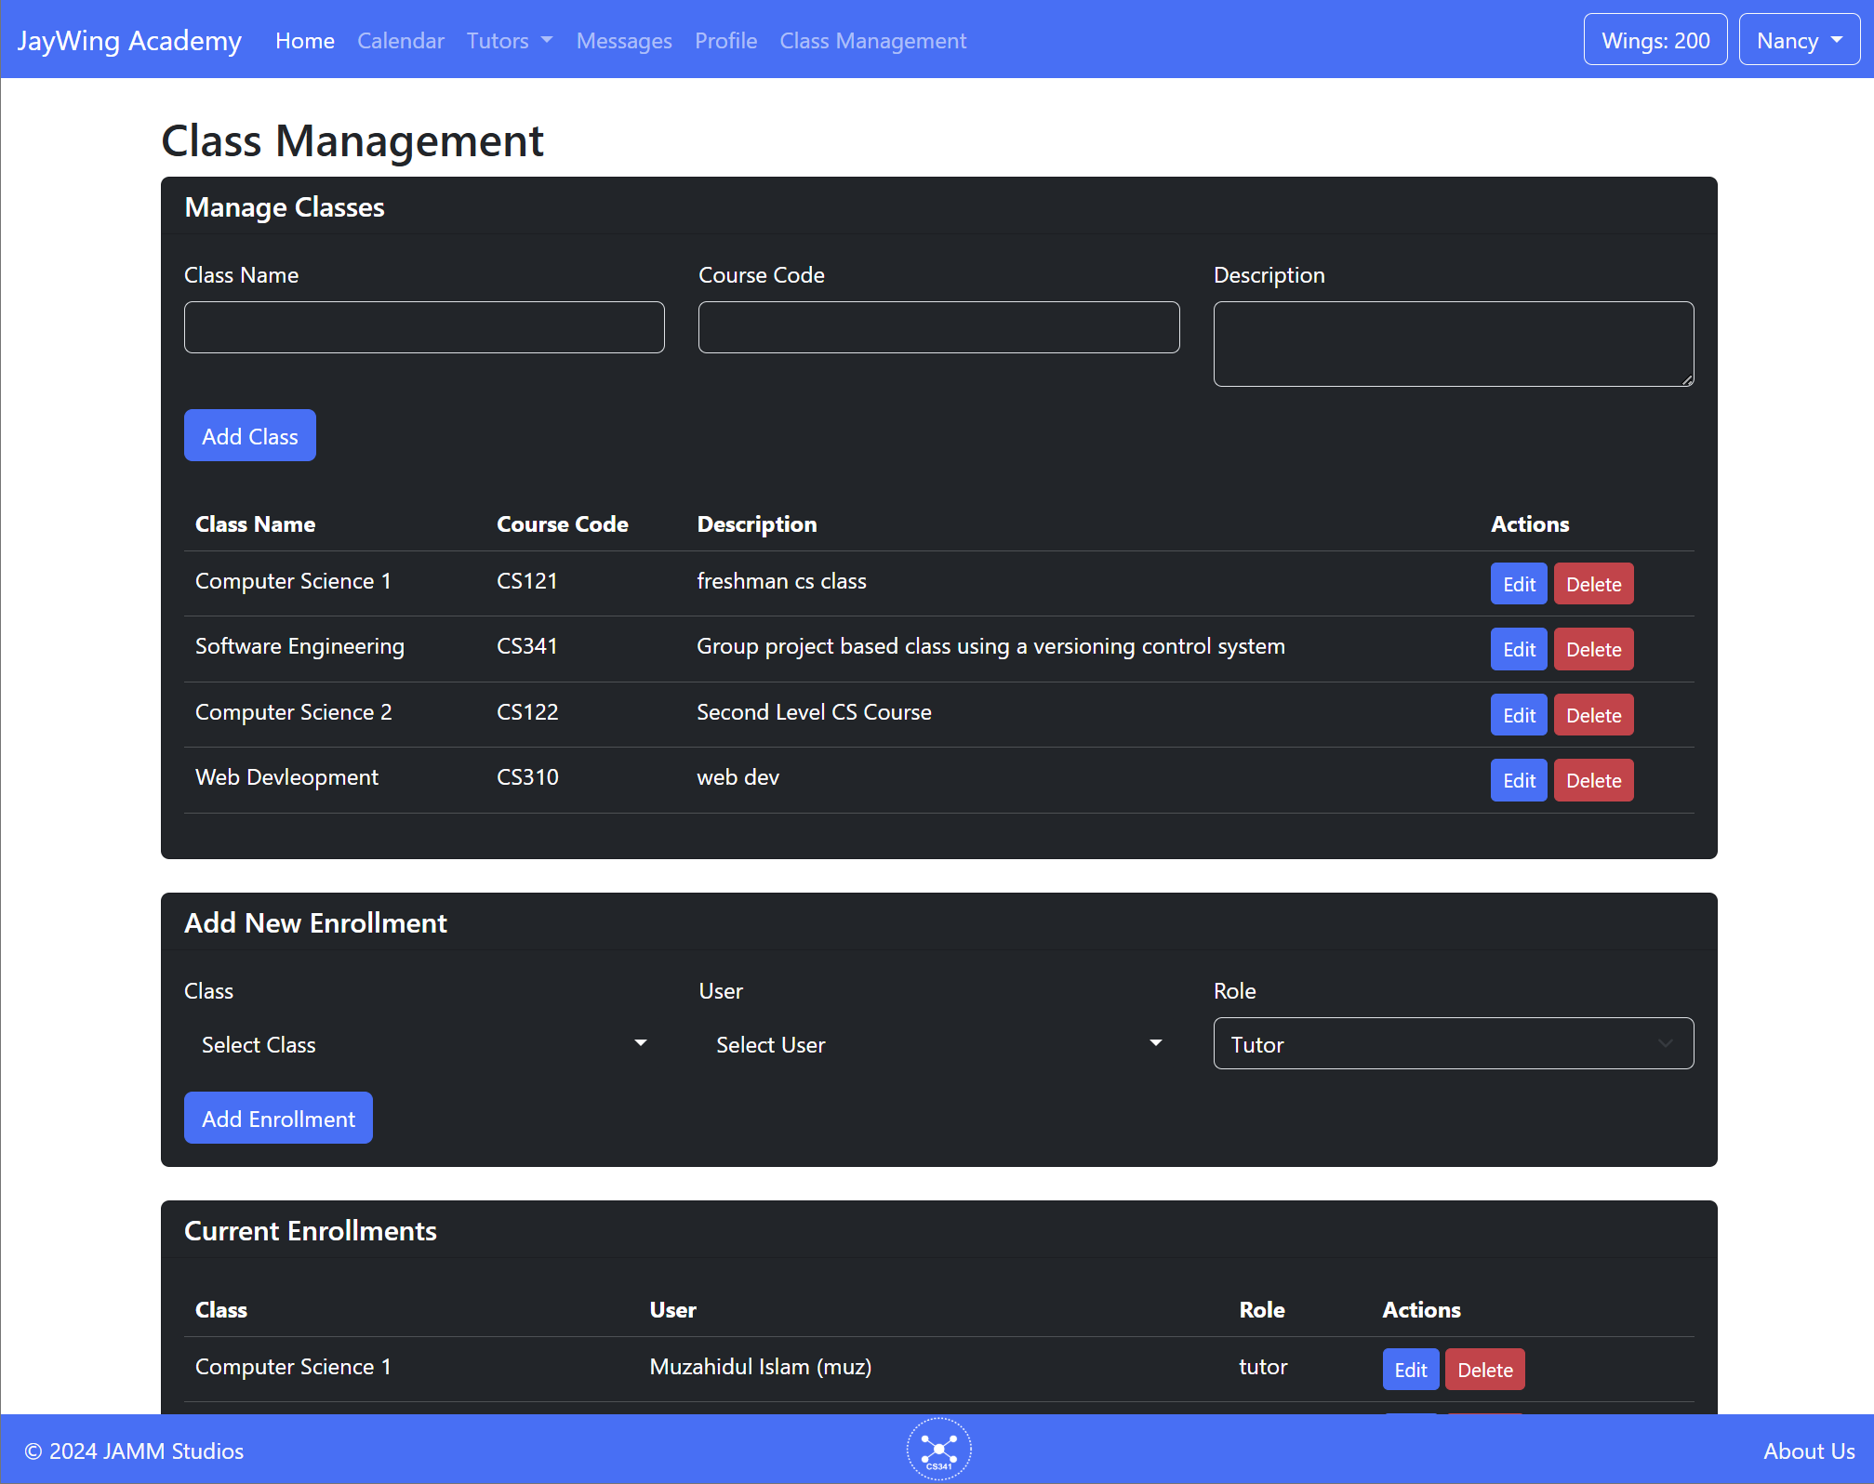
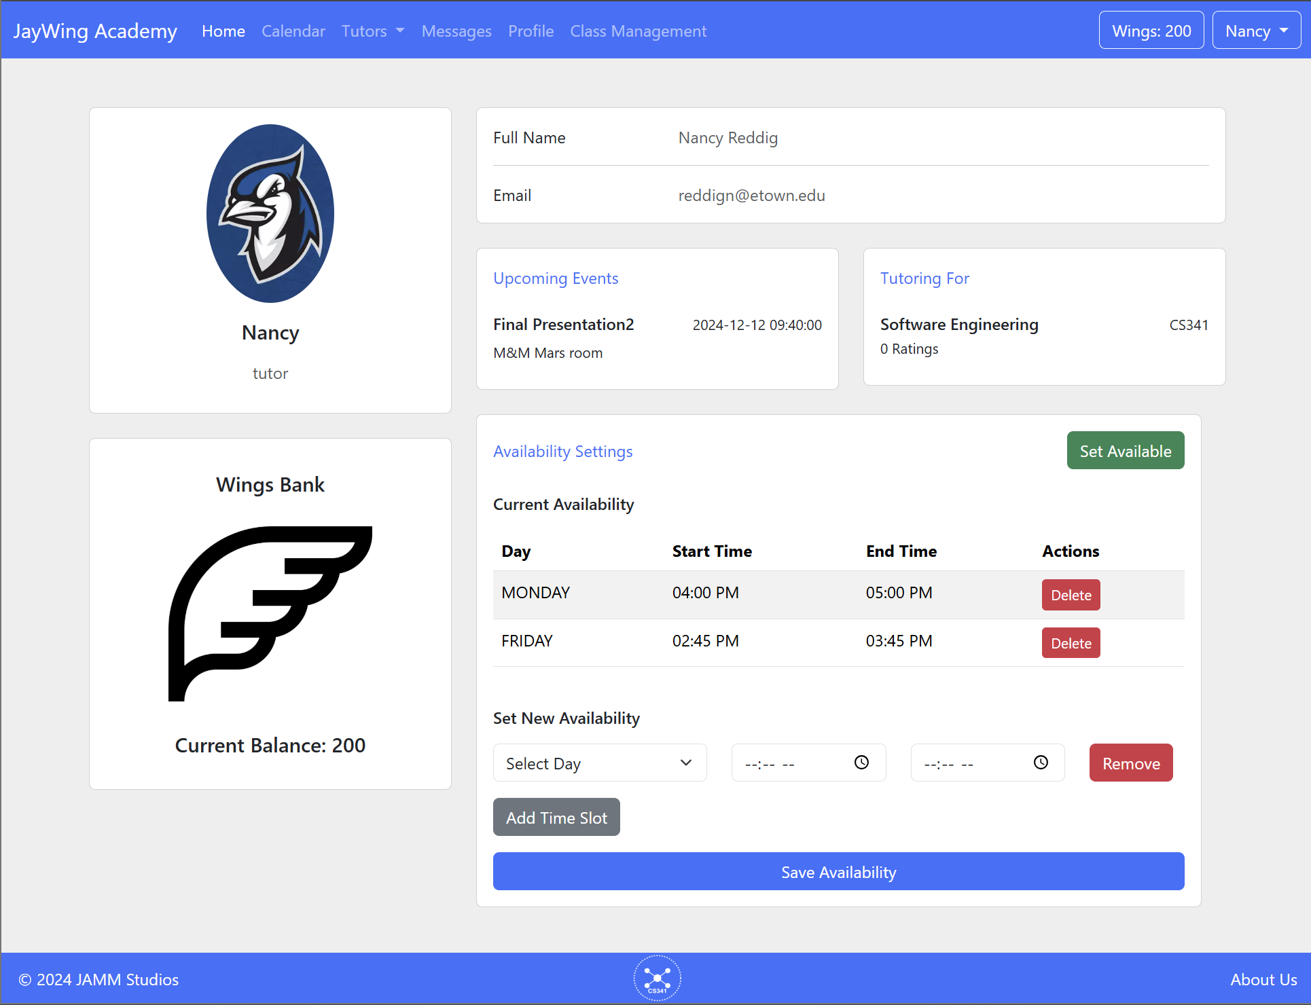
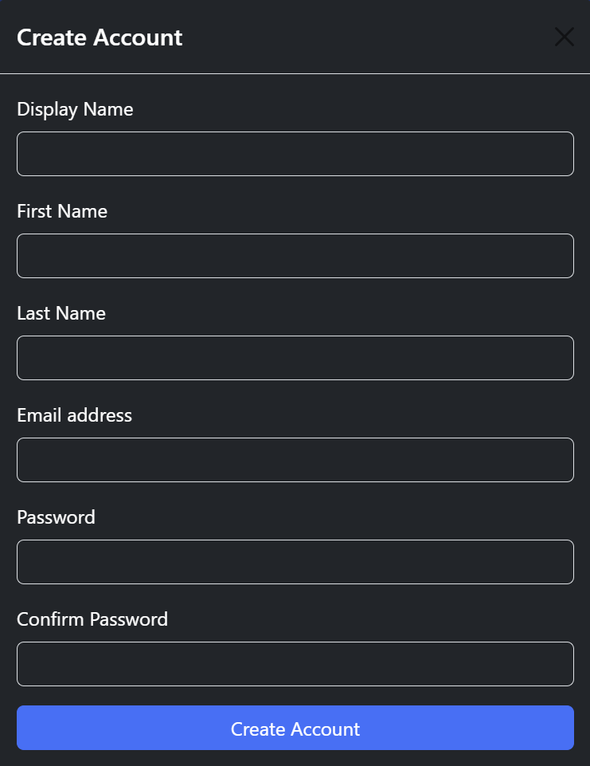
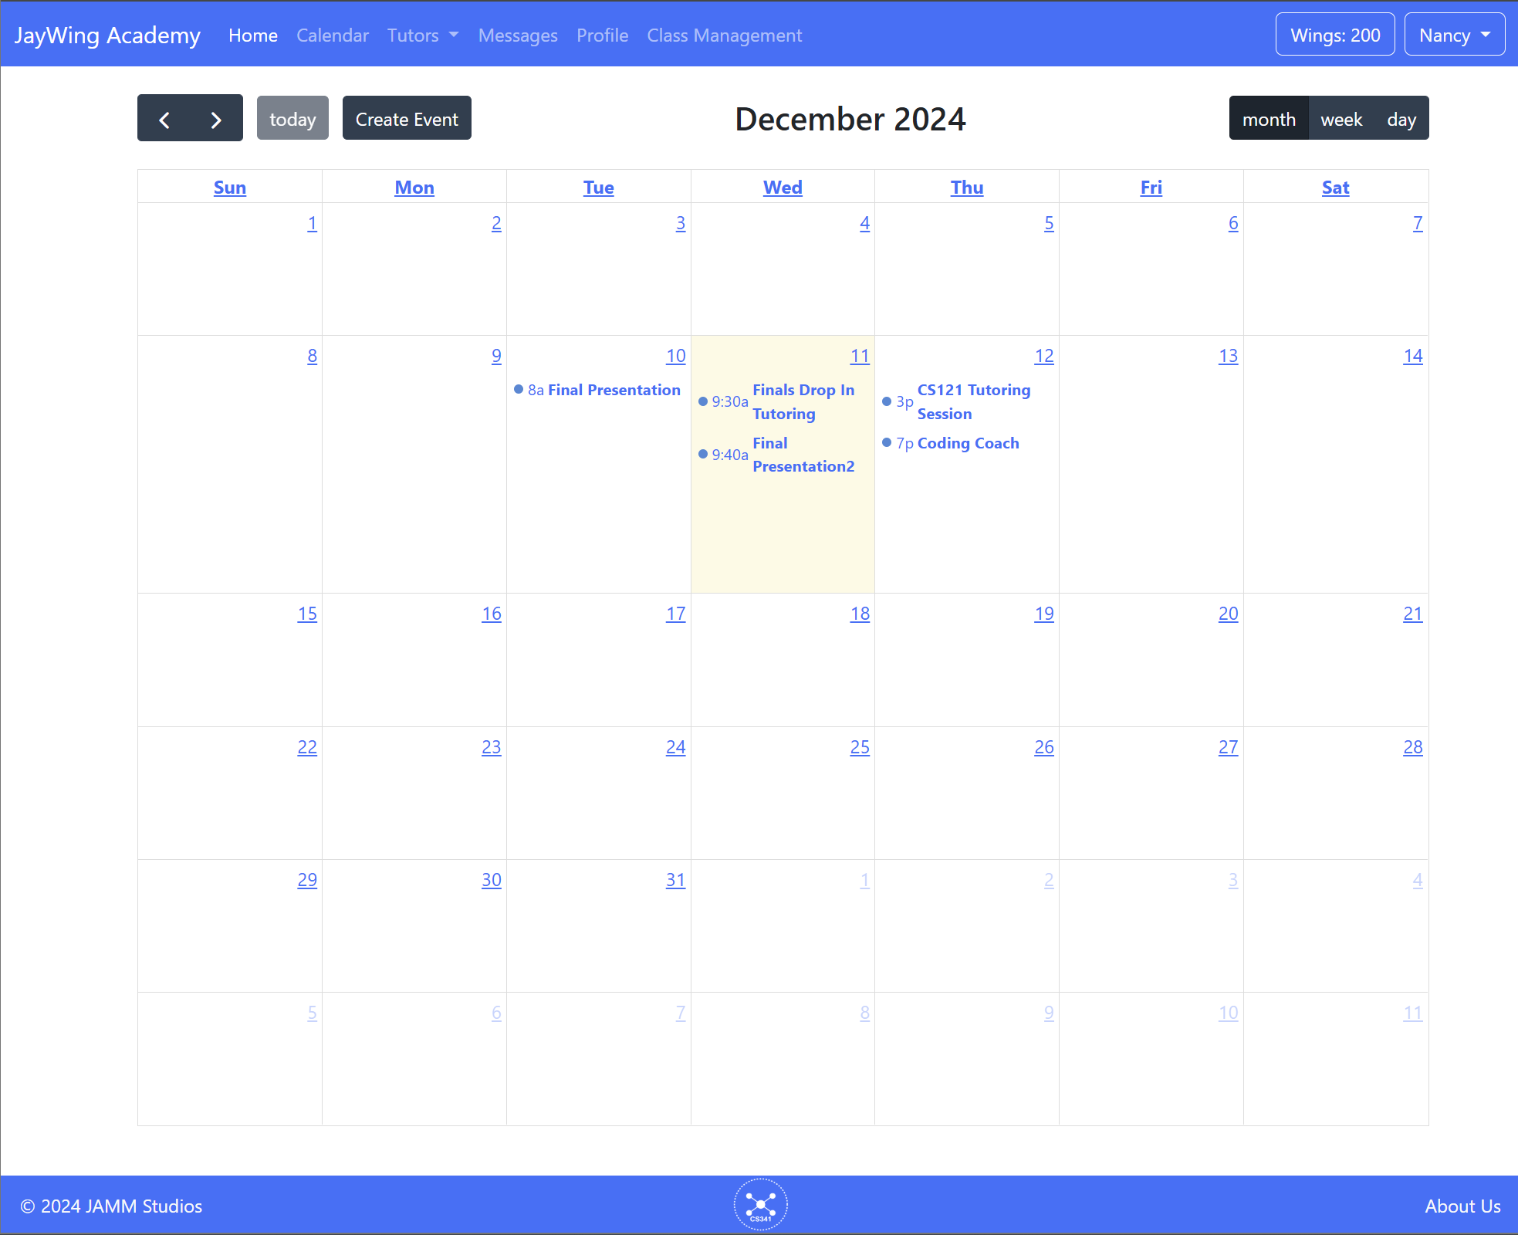
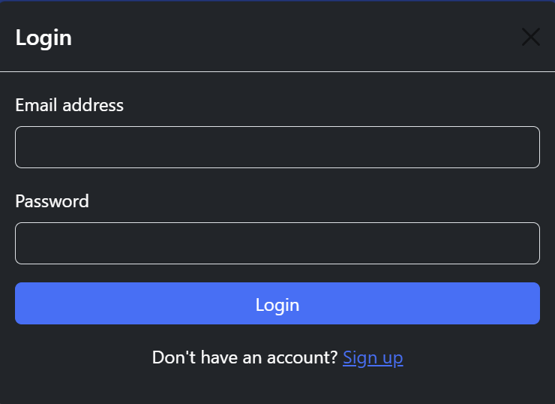
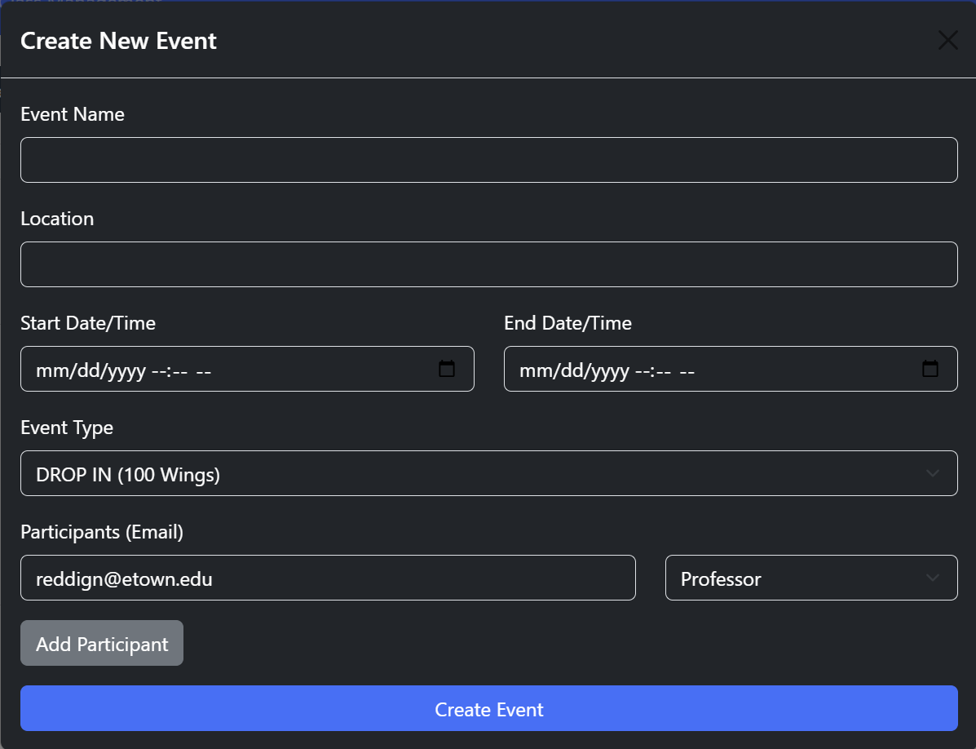
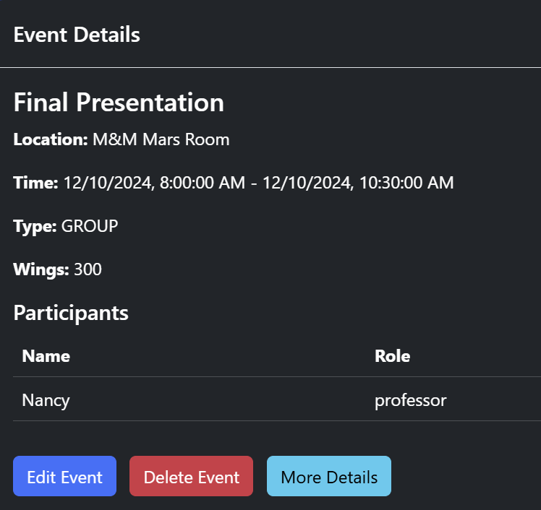
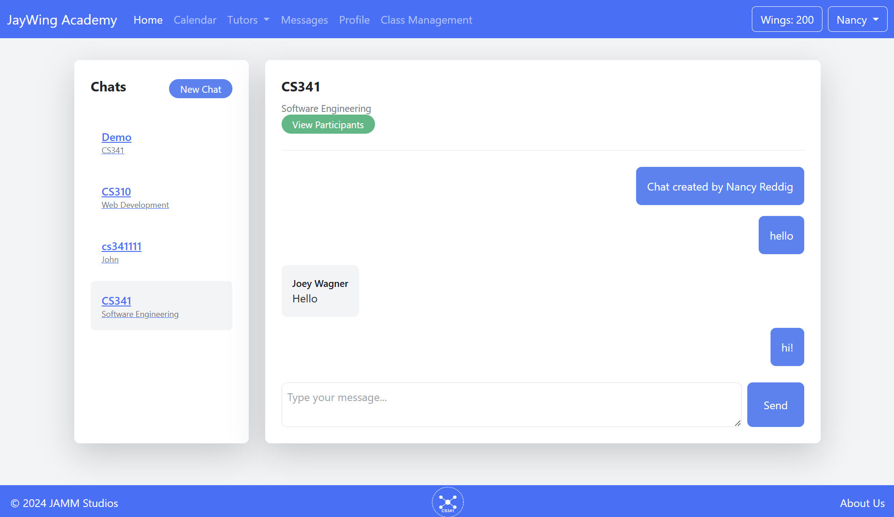
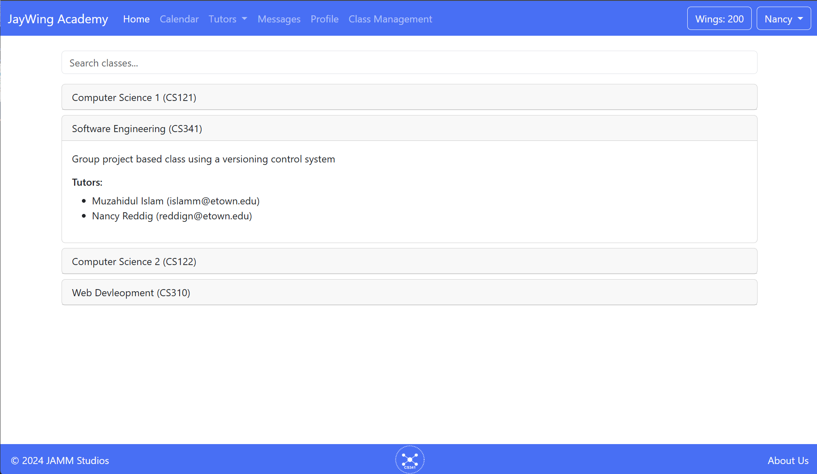
JayWing Academy
Alex Roop, Joey Wagner, Matt Smith, Muzahidul Islam
Professor Nancy Reddig
OPPORTUNITY/PURPOSE
Elizabethtown College offers various tutoring types, but their scattered nature can prevent students from receiving the help they need. JayWing Academy centralizes all campus tutoring to a single platform, providing faster, simpler services whilst offering incentives for participation and valuable academic insights to professors.
TECHNICAL DESIGN & DATA MODEL
DESIGN SPECIFICATIONS & SYSTEM REQUIREMENTS
Secure Registration & Login System
Global Calendar Page/Event Management
Create/Edit/Delete Events, Take Attendance, Reward Wings
Admin Page for Class Management
Site Admins Create/Edit/Delete Classes and Tutors/Tutees for Classes
Profile Page
Display User Info, Upcoming Events, Class Enrollment, Edit Availability
Private Messaging System
Find a Tutor/Job Board Inquiry
Search for Available Tutors and Submit Interest in Tutoring
IMPACT
JayWing Academy is a centralized tutoring system that enhances accessibility and reduces confusion, empowering students at Elizabethtown College to excel academically with greater ease and support.
Figure 1: Database Model
PROTOTYPE/PROCESS
Figure 4: Class Management Admin Page
Figure 6: Profile Page
Figure 2: Registration and Login System
Figure 3: Calendar and Event Management System
Figure 5: Messaging System
Figure 7: Find a Tutor
LESSONS LEARNED
Through this project, we gained hands-on experience with essential web development tools like Git for version control, Bootstrap for interactive design, and XAMPP for local simulation. We built a dynamic, interactive interface using HTML, CSS, and JavaScript, while managing web deployment with FTP. As a team, we navigated challenges such as distributing work across different skill levels and resolving design disagreements with the ERD model. Managing environments between XAMPP and the web server required careful attention to consistency and merging of desired and working features. These experiences improved our technical skills and taught us the value of collaboration and adaptability in development.
REFERENCES & ACKNOWLEDGEMENTS
Special Thanks to:
Professor Nancy Reddig, Computer Science Lecturer, for their guidance and instruction throughout CS 341.
Michelle Henry, Assistant Director of Academic Advising & Starfish, for her valuable insights.
Dr. Peilong Li, Associate Professor of Computer Science, Keagan Kinney and James Hutchins, Mindset Mentors, for their contributions to user stories.
Danielle Strausburger, TA & Senior Computer Science Student, for conceptualizing the original idea in Web Development CS 310.
Technical References
Bootstrap Documentation (Version 5.3)
URL: https://getbootstrap.com/docs/5.3/getting-started/introduction/
Software Engineering Project 2024
EDUCATE FOR SERVICE. ENGINEER FOR SOCIETY.
Notes:
Introduction. Include the student name, company name, internship location, internship position, and internship dates. Also note the course rubric and number, course title, and instructor(s). In addition, describe how you secured the internship.
Abstract. The abstract should provide a concise summary of what was done and learned in the internship and the course.
Learning Objectives. List 2 to 5 learning objectives that you had planned to achieve by completing the internship.
Description of Key Responsibilities. Summarize the major responsibilities, activities, and project(s) completed during the internship.
Application of VWU courses to the internship. Explain how your coursework helped with the internship. Link relevant courses, theories, and concepts to their applications within the internship.
Lessons Learned. Explain what you learned about the industry, the company, the career process, and yourself through the internship experience.
Acknowledgements. Recognize the people who helped you, including the internship site supervisor, the course instructor, and mentors. Include full titles in the acknowledgements. In addition, acknowledge funding sources.
Visuals. Incorporate visual aids to illustrate key points. Be sure to label all visuals. Include: names, dates, locations, and photographers. Do not include photographs of children unless you have secured approval from your site supervisor to use the children’s images.

